Slide 1
Healthy Kids, Happy Parents
Eating Organic On A Budget and boosting the immune system
Dr. Rhea Abbott
Dr. Mohammad Shegeft
Alpine Integrated Medicine
Notes:
Talk about providers

Slide 2
What is Naturopathic Medicine?
Naturopathic Medicine is a distinctively natural approach to health and healing that recognizes the integrity of the whole person and emphasizes the treatment of disease through the stimulation, enhancement, and support of the inherent healing capacity of the person.
Notes:
Talk about Naturopathic medicine

Slide 3
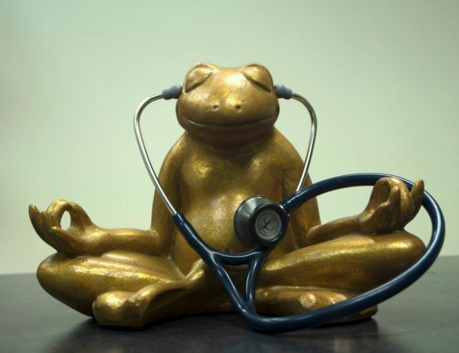
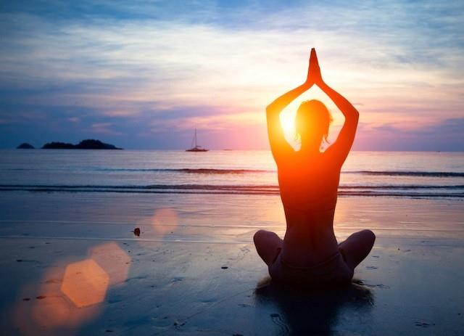
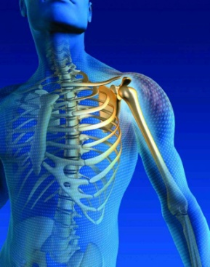
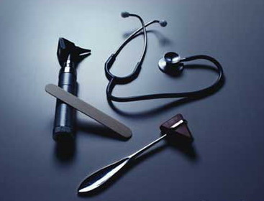
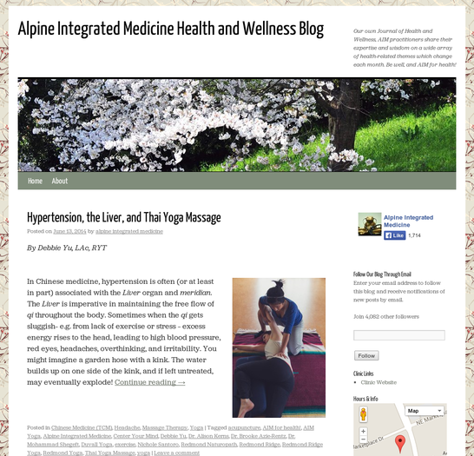
Alpine Integrated Medicine
AIM for health
Follow us on our:
Blog – aim4healthblog.com
Notes:
Talk about clinic and services offered…. Aim4Health…..

Slide 4
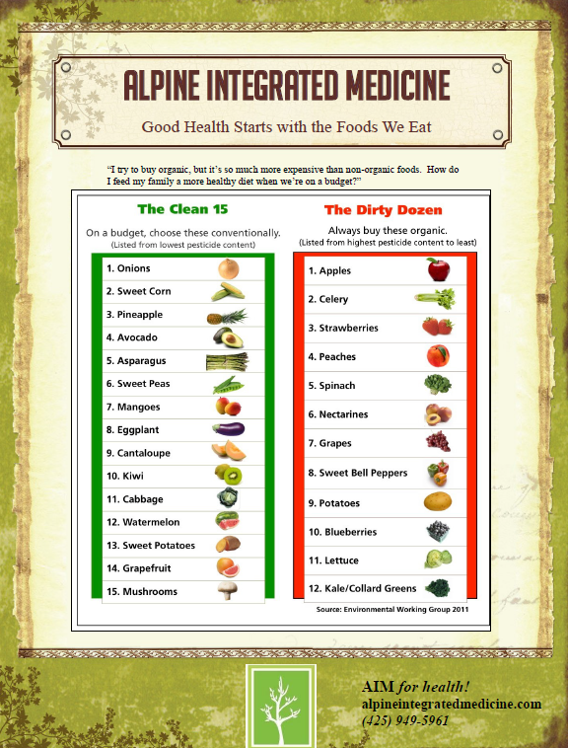
Topics:
Why Organic or Local?
Most Common Ailments of Elementary Aged Children
Eating the Colors of the Rainbow
The Dirty Dozen
Supplements

Slide 5
Why Organic or Local?
Up to 30% high in minerals, vitamins and key nutrients
Less pesticides and chemical residue (Harvard Study)
Less carbon footprint
Eating with the season

Slide 6
Most Common Ailments of this age?
URI, Cough, Conjunctivitis, Ear Infection
GI (Diarrhea, Constipation, Gastroenteritis)
Skin Disorders (Eczema, Psoriasis, Acne)

Slide 7
Gluten free, dairy free, and no food coloring or additives?
Gluten clouds the brain
ADD
Anxiety
Depression
Fatigue
Autism spectrum
Focus in general
Dairy is just sugar to the brain
Chemicals of food coloring lead to deactivation of methylation (MTHF-R)

Slide 8
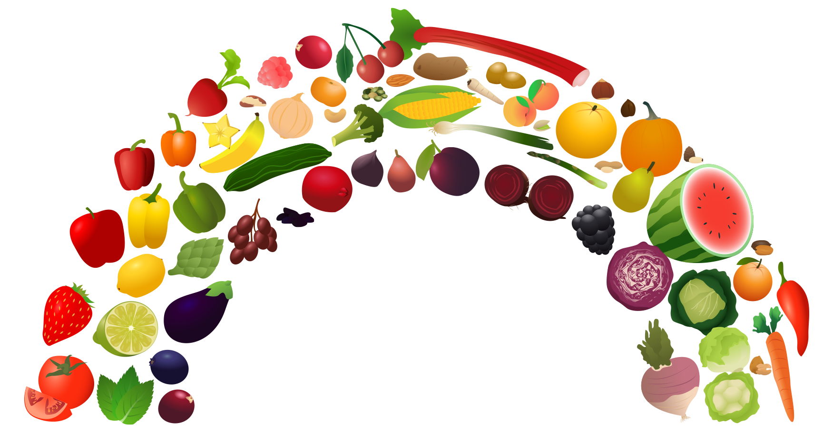
Eating the colors of the rainbow

Slide 9
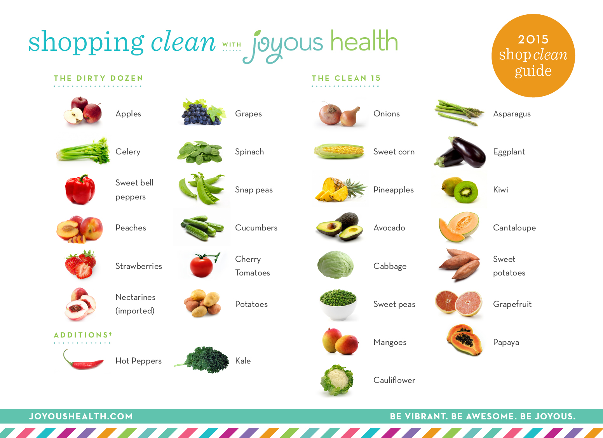
Dirty Dozen
http://www.joyoushealth.com/blog/2015/03/02/2015-dirty-dozen-shopping-organic-budget/

Slide 10
Foods to increase vitamin A and C
Vitamin A: Cantaloupe, apricots, carrots,
broccoli, spinach
Vitamin C: Lemon, lime, orange, grapefruit,
kiwi, papaya, strawberry, broccoli, bell
peppers, cabbage
Other supplements to consider
Probiotics
Vitamin D3/calcium
Omega-3
Mult-vitamins

Slide 11
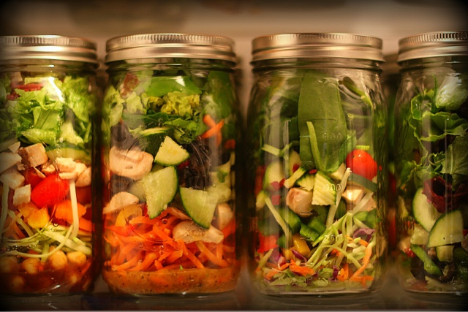
Immune Support Soup
1 small yellow onion, chopped
1-5 cloves of garlic, chopped or crushed
1 tsp – 3 Tbsp grated ginger
Juice of ½ lemon
¼ - ½ Shiitake mushrooms
1 quarter miso, chicken or vegetable broth
3 Tbsp fresh minced parsley
1 grated carrot

Slide 12
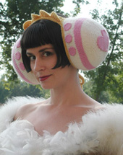
Onion Ear Muffs
Need:
½ yellow / white onion
Old T-shirt / Cheese cloth
Direction:
Microwave onion for 30-40 seconds until steaming. Check temperature on skin, want it to be as hot as can tolerate against skin. Wrap onion in 1 layer of old T-shirt/cheese cloth. Place wrapped onion directly up to effected ears(s). Can either hold in place or lie on effected side for 15-20 minutes.
Notes:
Body’s most important antioxidant because it is in the cell… shout out to Dr. Mo and his expertise in glutathione

Slide 13
CSAs: Community Support Agricultrue and Farmers Market
www.oxbow.org – We are a drop site for oxbow on Fridays
Http://redmondsaturdaymarket.org
HelloFresh.com – pick menus, foods in proportions are delivered
SunBasket.com – similar to HelloFresh but organic

Slide 14
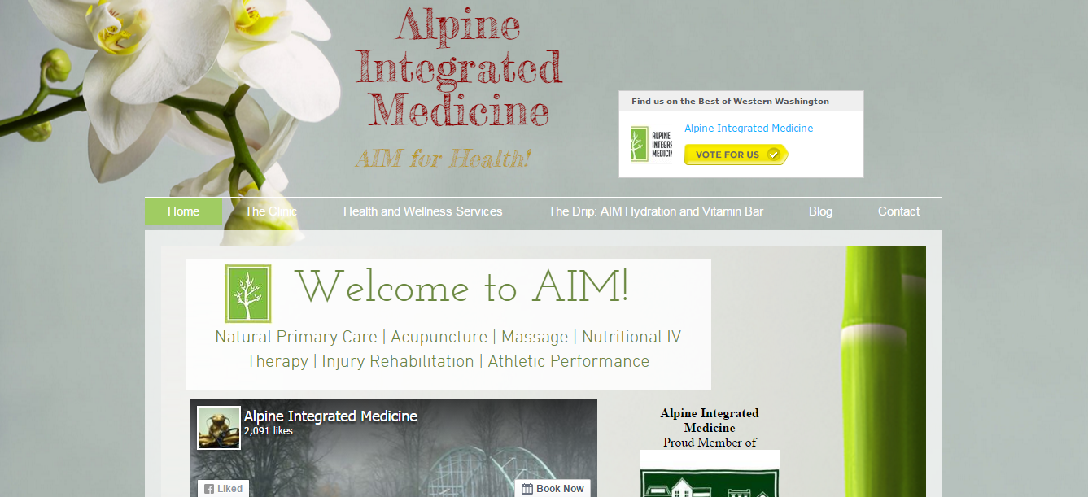
Dr. Mohammad Shegeft
Dr. Rhea Abbott
www.AlpineIntegratedMedicine.com
22635 NE Marketplace Dr. #130
Redmond, WA 98053 (425) 949–5961

